Slide 2
Objective
“To enrich every student’s school journey”

Slide 3
P.T.S.A
A PTA with a difference - S is for Student
We Represent ALL Ealing Fields Stakeholders
Parents – ALL Parents, Carers and wider family
Teachers – ALL Ealing Fields Staff & Governors
Students – ALL Ealing Fields Students
We encourage the students to be an active part of the PTSA by suggesting and voting on events and fundraising projects, as well as helping to run events through our PTSA Student Ambassador Programme.

Slide 4
Projects Funded
£7,500 for a Performance Sound System
£5,000 for the School Mini Bus
£885 for the Jack Petchey’s Speak Out Challenge Workshops
£700 for an Art Press
£500 for the school production of Oliver!
£475 for the maths Tagtiv8 programme
£383 for a Digital Oscilloscope
£204 for a Digital Joule / Watt Meter
Notes:
Consider links out to websites for Petchey and Tagtiv8

Slide 5
Fundraising
Year | Average No. of Students | Funds Raised | Amount per Student
2017 | 160 | £2,645 | £16.53
2018 | 280 | £6,252 | £22.33
2019 | 400 | £9,045 | £22.62
2020* | 520 | £2,830 | £5.44
*Covid 19 Pandemic – Majority of PTSA activities & events cancelled.
With a full school of 650+ students & the new site facilities we predict that
Ealing Fields PTSA has the potential to raise over £15,000 p.a. in normal circumstances.

Slide 6
The Big Bounce Back!
£7k in 7 Weeks!
Event | Funds Raised
2nd Hand Uniform Shop | £694
Back to School BBQ | £2,653
Year 7&8 Laser Tag | £1,158
Team Ealing Fields | £2,500
TOTAL | £7,005
Notes:
Add ‘And we’re not at 7 weeks yet, we have one more event to come…’

Slide 7
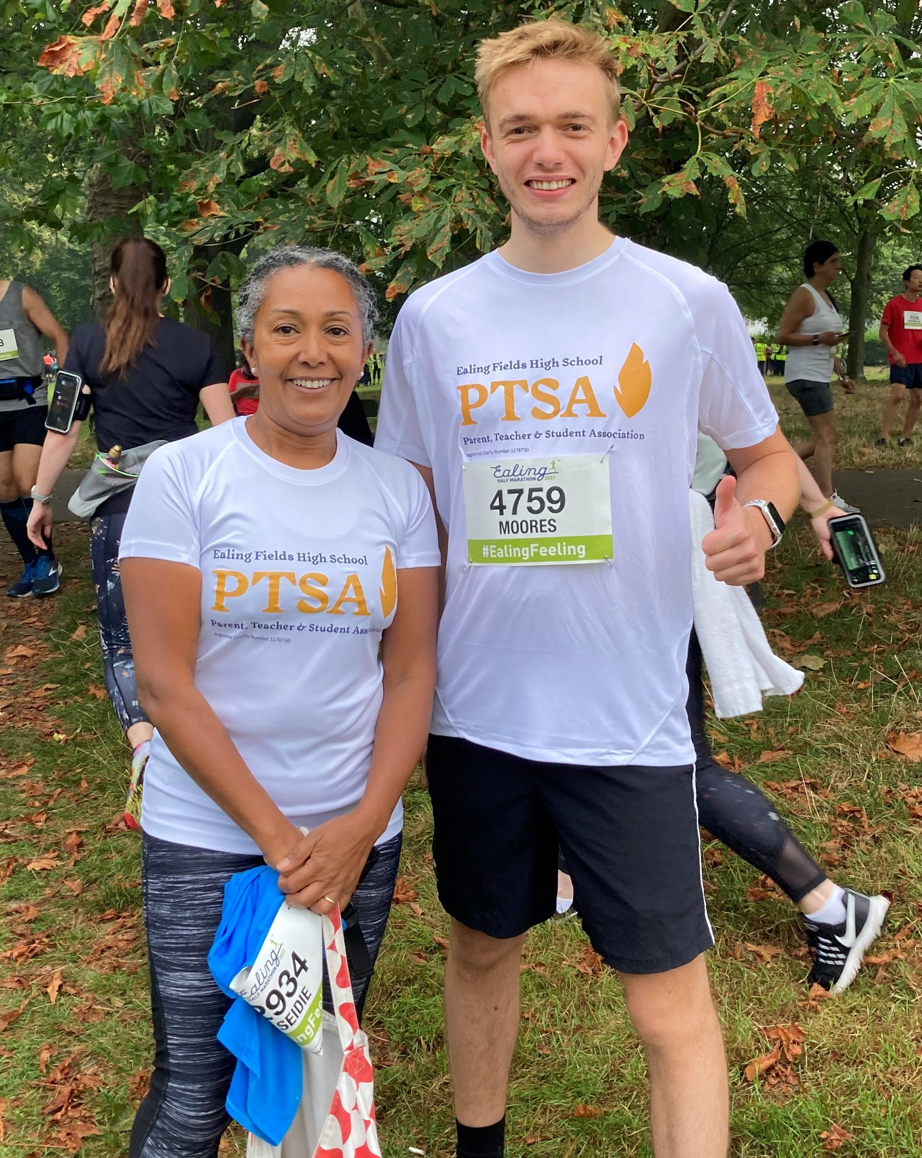
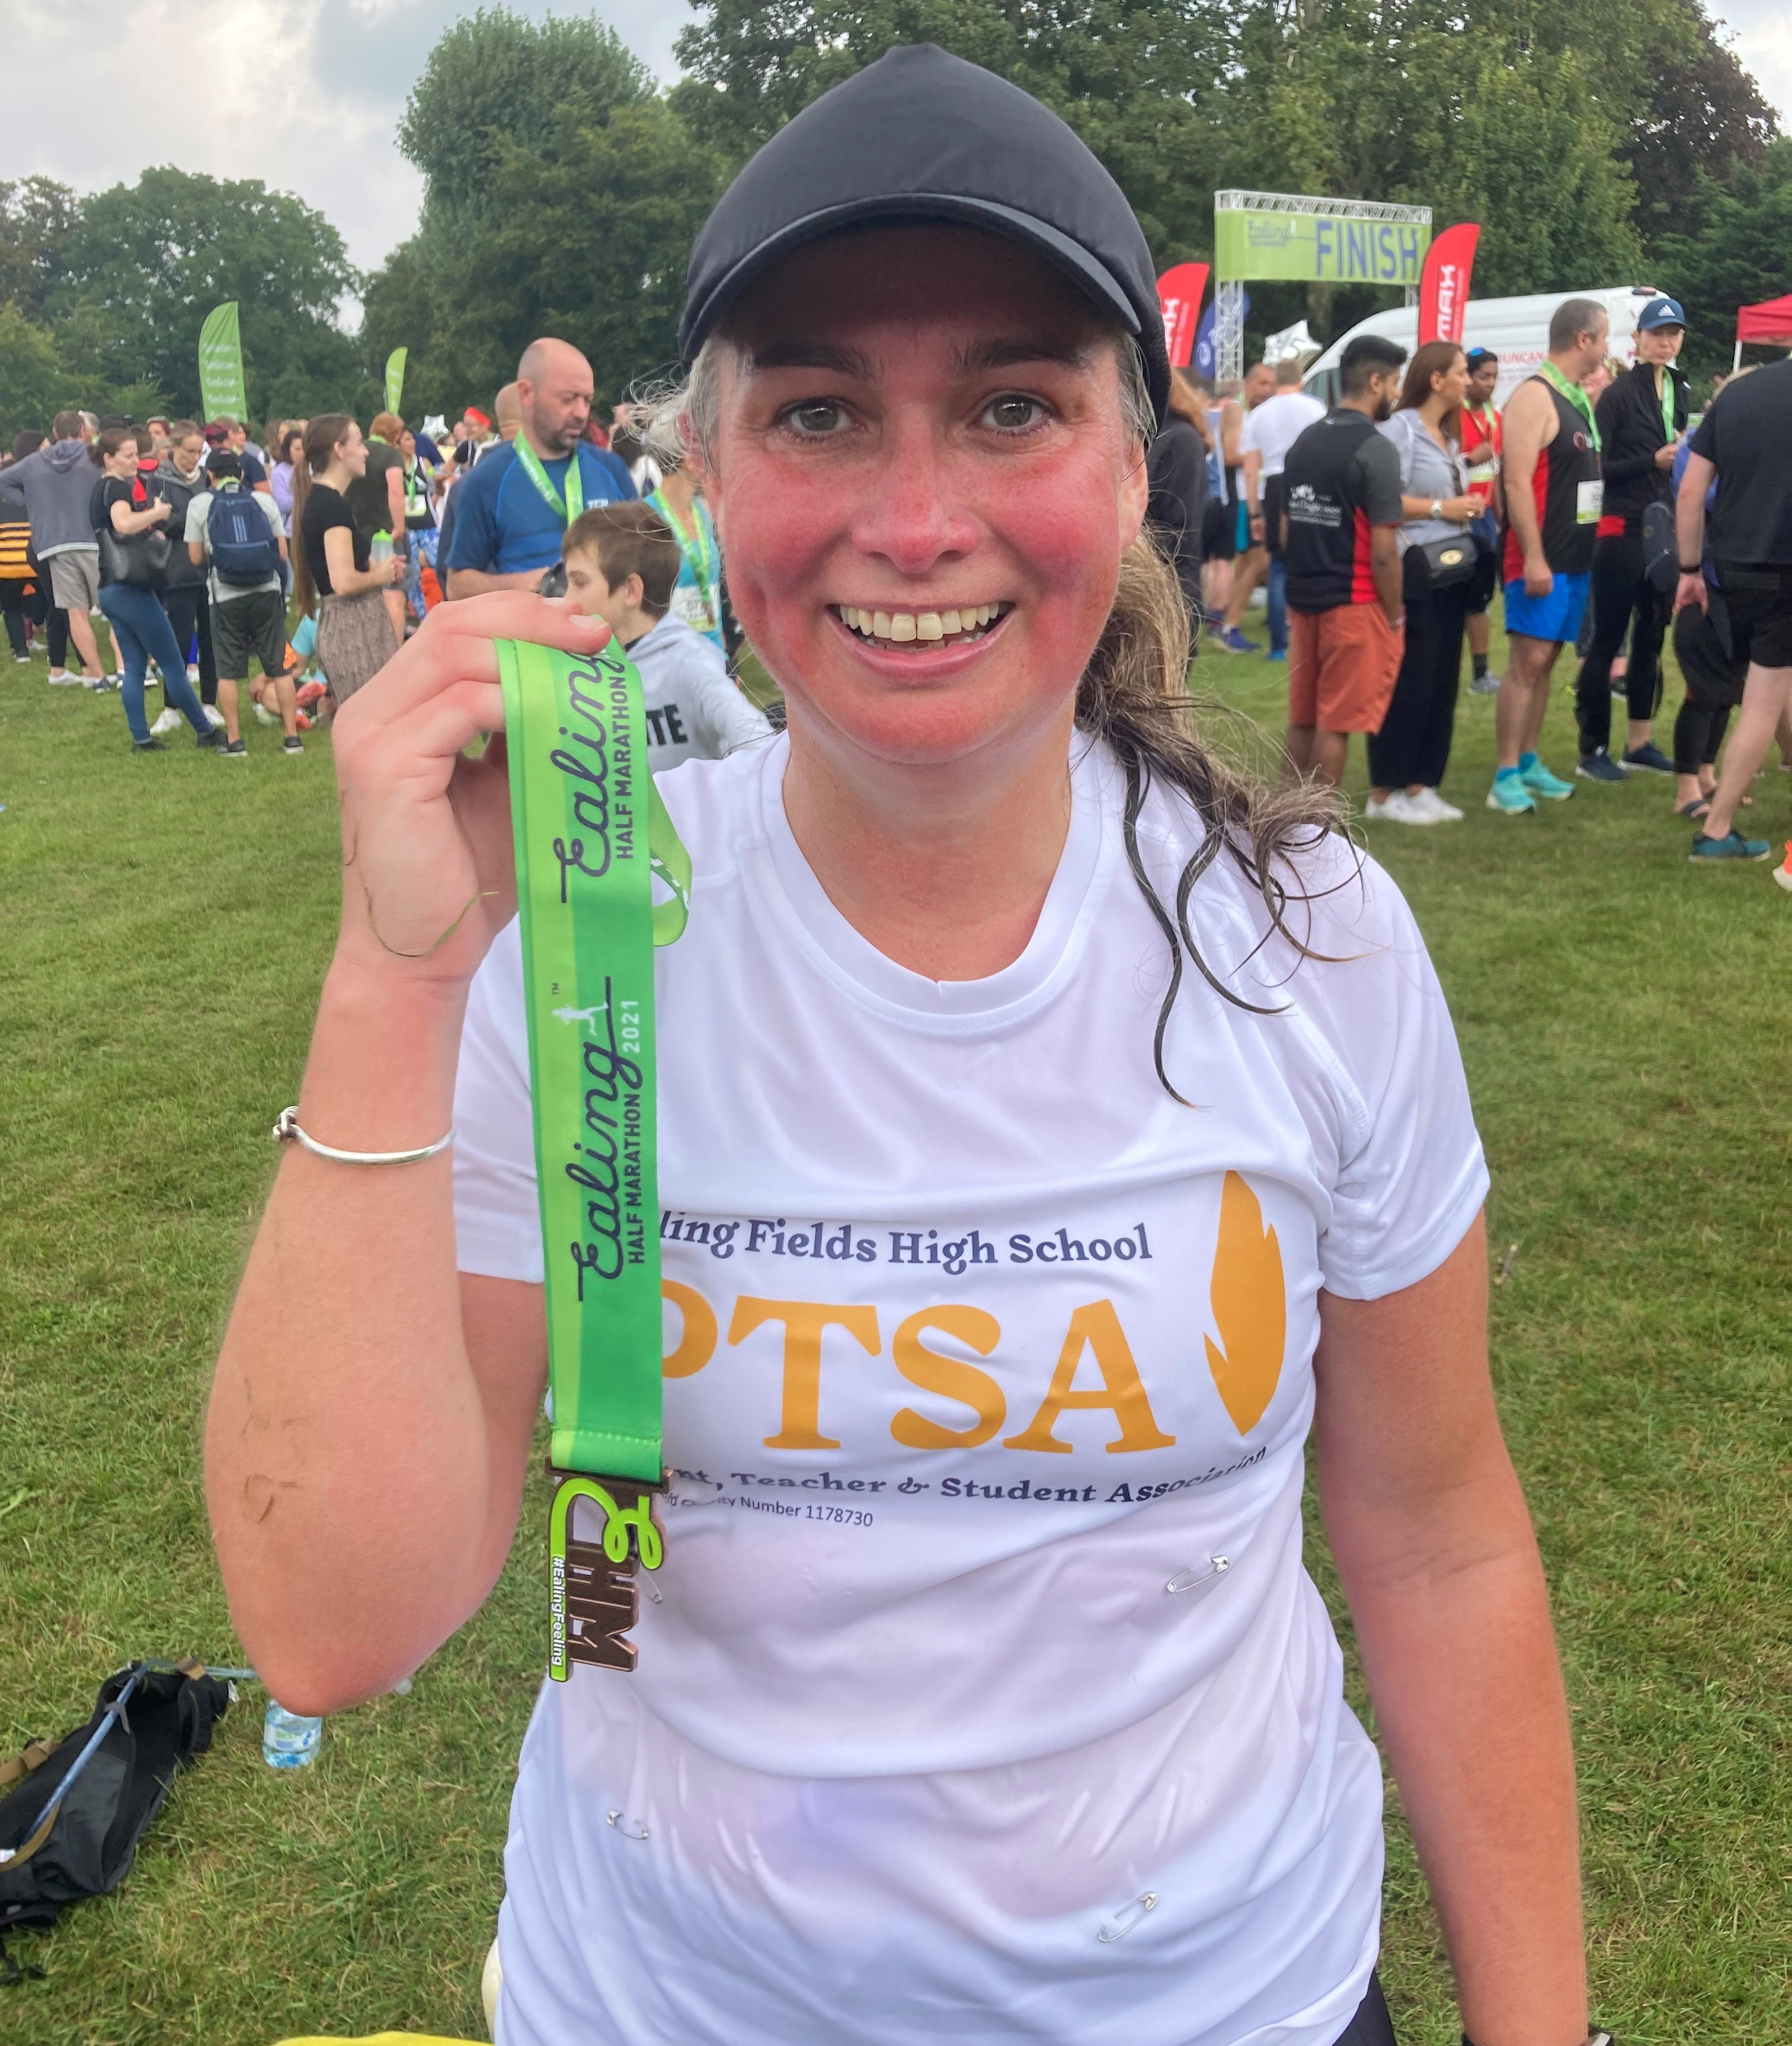
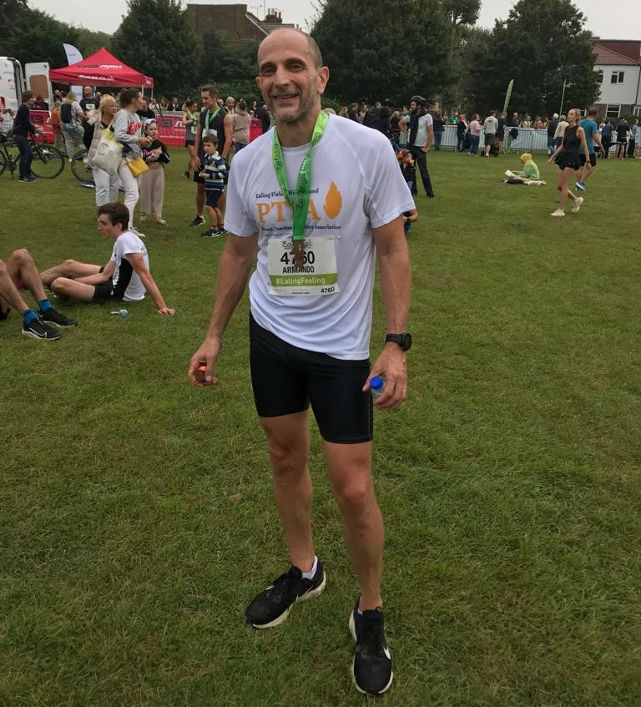
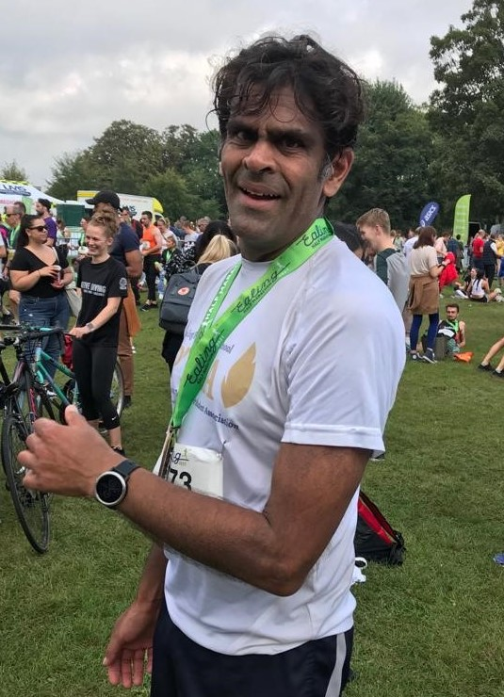
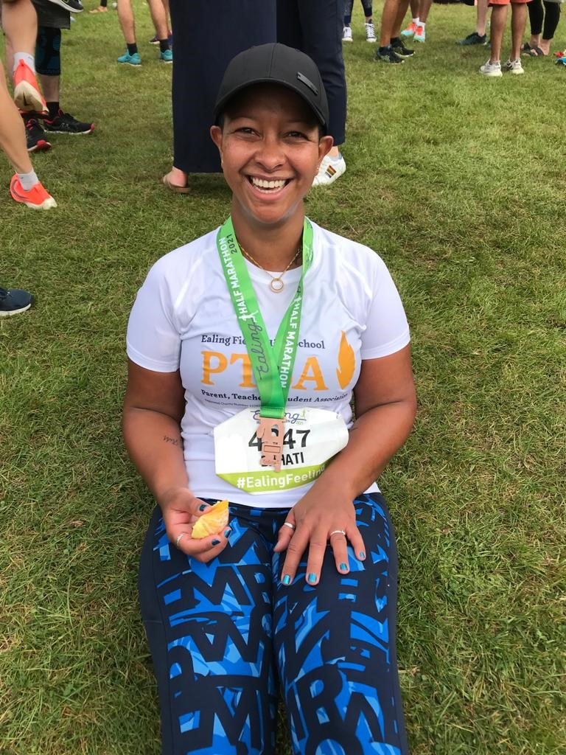
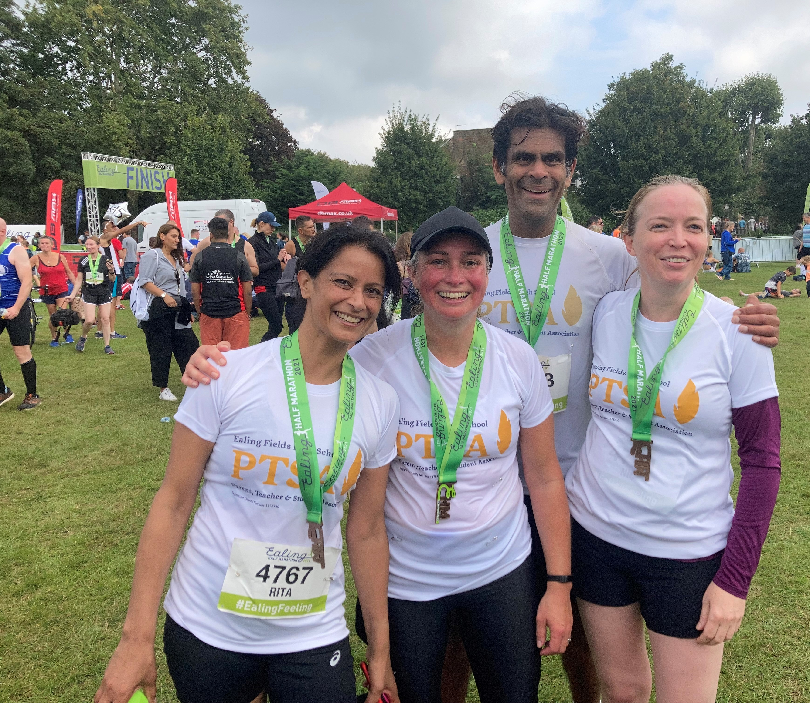
Well Done Team Ealing Fields!
But we’re not done yet! There is one more event to come before the 7 weeks are up…

Slide 8
PTSA Events Schedule 2021/22
Year 7 Movie Night
Friday 15th October, 5.00 – 8.00 pm
Year 8 Movie Night
Friday 5th November, 5.00 – 8.00 pm
Stand Up Comedy Night (Adults only)
Friday 12th November, 6.00 – 9.45 pm
Quiz & Curry Night (Students v Adults)
Friday 4th February, 6.00 – 9.45 pm
Rugby Day
Saturday 12th March, 2.00 – 7.00 pm
Years 9&10 Laser Tag
Friday 6th May, 6.00 – 9.00 pm
Ealing Fields Festival
Friday 8th or Saturday 9th July – T.B.C.

Slide 9
Fundraising Projects 2021/22
School Library
Wellness Centre
Debating Chamber
Outdoor Activities Equipment
Department Grants

Slide 10
School Library
Update from Ms J Trewin – Deputy Headteacher
The library needs about £30,000 investment long-term
About £10,000 raised from Governor’s Fund
About £5,000 raised from Private Business
1 Book per Student – Each Students gets to chose a book
What can the PTSA do to help?
PTSA to raise further £5,000 for 2021/22
Notes:
Take the PTSA bullet point out and box it out at the bottom of the slide titled ‘What we PTSA can do to help:’

Slide 11
Wellness Centre
Update from Mr M Tootell – Head of Sports
£10,000 grant received from London Sport
£1,070 raise through crowd fundraising (Mr Ts cycle ride)
£11,000 of equipment to be installed over October half term
£2,000 grant applied to British rowing
What can the PTSA do to help?
PTSA to raise further £5,000 to complete project
Notes:
Take the PTSA bullet point out and box it out at the bottom of the slide titled ‘What we PTSA can do to help:’

Slide 12
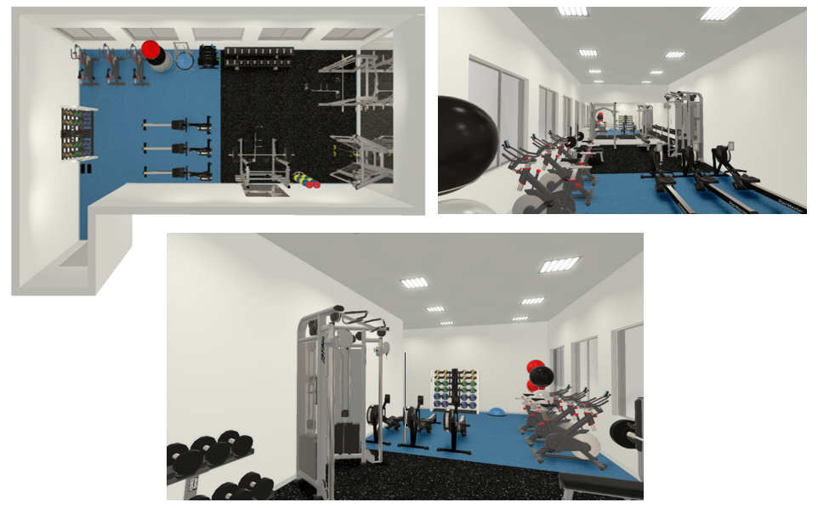
Notes:
Wording to be blue to match other slides

Slide 13
A wellness centre to be used by both staff and students. Staff can use the centre as a fitness suit to benefit their well-being. A positive well-being will have a positive effect on teaching and learning inside the classroom. Use of the centre will be free of charge, and available outside of curriculum and extra-curricular time. As part of risk mitigation, staff will go through a fitness induction of how to use the equipment safely before using the centre.
The centre should also be used for students in curriculum and extra-curricular time. Students will learn and practice key concepts of physical training, which is a key aspect of the GCSE PE and BTec curriculum. During this time, the centre will be supervised by a PE staff member who will be proficient in exercise safety. Appropriate risk assessment will be made and agreed upon before opening of the centre.
The centre will also be available for use for the inclusion department, to run exercise interventions for in-need students.

Slide 14
Shop Online to Raise Funds
for Ealing Fields PTSA
www.easyfundraising.org.uk
Ealing Fields High School
www.smile.amazon.co.uk
At NO Cost to You!

Slide 15
Communications & Notifications
Like, Follow, Click, Send, Explore…….
@EalingFieldsPTSA
@EFPTSA
ef_ptsa
PTSA@ealingfields.co.uk
WhatsApp Broadcast Notifications – Coming Soon
www.ealingfields.org.uk/about-us/ptsa

